Slide 1
IV054
CHAPTER 10: Identification and Authentication,
Secret sharing and E-commerce applications
Most of today's applications of cryptography ask for authentic data rather than secret data. The main problem is how to protect data and communication against an active attack.
Main problems to deal with:
User identification (authentication): How can a person prove his (her) identity?
Message authenticity: Can tools be provided to decide for the recipient that the message is from the person who is supposed to send it?
Message integrity: Can tools be provided to decide for the recipient whether or not the message was changed?
One practical objectives is to find an identification scheme that is simple enough so that it can be implemented on smart cards - they are essentially credit cars equipped with a chip that can perform arithmetical operations and communications.
E-commerce: One of the main new application of the cryptographic techniques is to establish secure and convenient manipulation with digital money, especially for e-commerce.
Identification and Authentication

Slide 2
IV054
AUTHENTICATION
Authentication (or entity (user) authentication or identification) is a process in which one party (referred often as a Prover) convinces the second party (referred often as a Verifier) of Prover’s identity and that the Prover has actually participated in the authentication process (I.e that the Prover is active in the time the confirmative evidence of identity is acquired).
The purpose of any authentication process is to preclude some impersonation (zosobnenie).
Authentication serves to control access to a resource (often a resource should be accessed only by a privileged user).
Identification and Authentication

Slide 3
IV054
OBJECTIVES of AUTHENTICATION
Authentication has to satisfy the following objectives:
The Verifier has to accept Prover’s identity if both parties are honest;
The Verifier cannot later, after successful authentication, pose as a Prover and authenticate himself to another Verifier;
A dishonest party that claims to be other party has only negligible chance to authenticate itself successfully;
Each of the above conditions remains true even if an attacker has observed or has participated in several authentication protocols.
Identification and Authentication

Slide 4
IV054
Identification using a PKC system
Alice chooses a random r and sends e _{B} (r) to Bob.
Alice identifies a communicationg persdon as Bob if he can send back r.
Bob identifies a communicating person as Alice if she can send him r.
A misuse of the above system
We show that (non-honest) Alice could misuse the above identification system.
Indeed, Alice could intercept a communication of a Jane ( a new “player'') with Bob, and get a cryptotext e _{B} (w) Jana has been sending to Bob, and then Alice could send e _{B} (w) to Bob.
Honest Bob, who follows fully the protocol, would then return w to Alice and she would get this way the plaintext w.
Identification and Authentication

Slide 5
IV054
ELEMENTARY PROTOCOLS
USER IDENTIFICATION
Static means of identification: People can be identified by their attributes, possessions (passports), knowledge.
Dynamic means of identification: Challenge and respond protocols.
Both Alice and Bob share a key k and a one-way function f _{k}.
Bob sends Alice a random number or string RAND.
Alice sends Bob PI = f _{k} (RAND).
If Bob gets PI, then he verifies whether PI = f _{k} (RAND).
If yes, he starts to believe that the person he communicated with is Alice.
The process can be repeated to increase probability of correct identification.
Message authentication
MAC - method (Message Authentication Code) Alice and Bob share a key k and a encoding algorithm A
1. With a message m, Alice sends (m, A _{k} (m)) - MAC
2. If Bob gets (m', MAC), then he computes A _{k} (m') and compares it with MAC.
Identification and Authentication

Slide 6
IV054
MAC in practice
Let n be a fixed message length.
Let f map a key and a message of the length n into a message of length n
Message m is divided into blocks m ₁, m ₂,… of length n
2. The following computation is done:
c ₁ = f _{k} (m ₁)
c _{i} = f _{k} (c _{i-1} ⊕ m _{i}), i = 2,3,…
MAC computed this way has a fixed length and depends on the whole message.
Identification and Authentication

Slide 7
IV054
Disadvantage of static identification schemes
Everybody who knows your password or PIN can impersonate you.
Zero-knowledge identification schemes
Using so called zero-knowledge identification schemes you can identify yourself without giving to the authenticator the ability to impersonate you.
Identification and Authentication

Slide 8
IV054
Simplified Fiat-Shamir identification scheme
A trusted authority (TA) chooses: large random primes p,q , computes n = pq;
and chooses a quadratic residue v ∈ QR _{n}, and s such that s ² = v (mod n).
public-key: v
private-key: s (that Alice knows, but not Bob)
Identification protocol
(1) Alice chooses a random r < n, computes x = r ² mod n and sends x to Bob.
(2) Bob sends to Alice a random bit b.
(3) Alice sends Bob y = rs ^{b} mod n
(4) Bob identifies sender as Alice if and only if y ² = xv ^{b} mod n, what is taken as prooof that the sender knows a square root of x and of v.
This protocol is a so-called single accreditation protocol also Zero Knowledge Proof
Alice proves her identity by convincing Bob that she knows square root of s (without revealing s to Bob).
If protocol is repeated t times, Alice has a chance 2 ^{-t} to fool Bob if she does not known s.
Identification and Authentication

Slide 9
IV054
Analysis of Fiat-Shamir identification I
public-key: v
private-key: s (of Alice) such that s ² = v.
Protocol
(1) Alice chooses a random r < n, computes x = r ² mod n and sends x to Bob.
(2) Bob sends to Alice a random bit b.
(3) Alice sends Bob y = rs ^{b}.
(4) Bob verifies if and only if y ² = xv ^{b} mod n, proving that Alice knows a square root of x.
Identification and Authentication

Slide 10
IV054
Analysis of Fiat-Shamir identification II
Analysis
The first message is a commitment by Alice that she knows square root of x.
The second message is a challenge by Bob.
If Bob sends b = 0, then Alice has to open her commitment and reveals r.
If Bob sends b = 1, the Alice shows her secret s in an “encrypted form''.
The third message is Alice's response to the challenge of Bob.
Completeness If Alice knows s, and both Alice and Bob follow the protocol, then the response rs ^{b} is square root of xv ^{b}.
It can be shown that Eve can cheat with probability of success ½ as follows:
Eve chooses random r ∈ Z_{n}*, random b ₁ ∈ {0,1} and sends x = r ² v ^{-b1}, to Bob.
Bob chooses b ∈ {0,1} at random and sends it to Alice.
Alice sends r to Bob.
Identification and Authentication

Slide 11



IV054
Fiat-Shamir identification scheme parallel version
In the following parallel version of Fiat-Shamir idenitification scheme the probability of false identification is decreased.
Choose primes p,q, compute n = pq.
Choose quadratic residues v ₁,…,v _{k} ∈ QR _{n}.
Compute s ₁,…,s _{k} such that
public-key: v ₁,…,v _{k}
secret-key: s ₁,…,s _{k} of Alice
(1) Alice chooses a random r < n, computes a = r ² mod n and sends a to Bob.
(2) Bob sends Alice a random k-bit string b ₁… b _{k}.
(3) Alice sends to Bob
(4) Bob accepts if and only if
Alice and Bob repeat this protocol t times, until Bob is convinced that Alice knows s₁,…,s_{k} .
The chance that Alice fools Bob is 2 ^{-kt}, a decrease comparing with the chance 1/2 of the previous version of the identification scheme.
Identification and Authentication

Slide 12
IV054
The Schnorr identification scheme - setting
This is a practically attractive, computationally efficient (in time, space + commun.) scheme which minimizes storage + computations performed by Alice (smart card).
Scheme requires also a trusted authority (TA) which
(1) chooses: a large prime p < 2 ⁵¹²,
a large prime q dividing p -1 and q < 2 ¹⁴⁰,
an α ∈ Z _{p}* of order q,
a security parameter t such that 2 ^{t} < q,
a secure hash function and p, q, α, t are public.
(2) establishes: a secure digital signature scheme with a secret signing algorithm sig _{TA} and a public verification algorithm ver _{TA}.
Protocol for issuing a certificate to Alice
1. TA establishes Alice's identity by conventional means and forms a string ID(Alice) which contains identification information.
2. Alice chooses a secret random 0 < a < q -1 and computes
v = α ^{-a} mod p
and sends v to the TA.
3. TA generates signature
s = sig _{TA} (ID(Alice), v)
and sends to Alice the certificate C (Alice) = (ID(Alice), v ,s)
Identification and Authentication

Slide 13

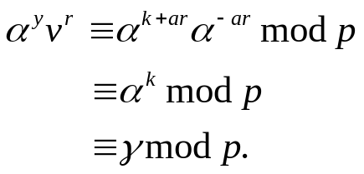
IV054
Schnorr identification scheme
1. Alice chooses a random 0 < k < q and computes
γ = α ^{k} mod p.
2. Alice sends her certificate C (Alice) = (ID(Alice), v, s) and γ to Bob.
3. Bob verifies the signature of the TA by checking that
ver _{TA} (ID(Alice), v, s) = true.
4. Bob chooses a random 1 < r < 2 ^{t}, where t < lg q is a security parameter and sends it to Alice (often t < 40).
5. Alice computes and sends to Bob
y = (k + ar) mod q.
6. Bob verifies that
This way Alice shows her identity to Bob. Indeed,
Total storage: 512 bits for ID(Alice), 512 bits for v, 320 bits for s (if DSS is used), total - 1344 bits.
Total communication: Alice → Bob 1996 bits,
Bob → Alice 40 bits.
Identification and Authentication

Slide 14
IV054
Shamir's threshold secret sharing scheme
Secret sharing schemes distribute a “secret'' among several users in such a way that only predefined sets of users can “assemble'' the secret.
For example, a vault in the bank can be opened only if at least two out of three responsible employees use their knowledge and tools to open the vault.
An important special simple case of secret sharing schemes are threshold secret sharing schemes at which a certain threshold of participant is needed and sufficient to assemble the secret.
Definition Let t Ł n be positive integers. A (n, t)-threshold scheme is a method of sharing a secret S among a set P of n participants (P = { P _{i} | 1 Ł i Ł n}), in such away that any t, or more, participants can compute the value S, but no group of t -1, or less, participants can compute S.
Secret S is chosen by a “dealer'' D Ď P.
It is assumed that the dealer “distributes'' the secret to participants secretly and in such a way that no participant knows shares of other participants.
Identification and Authentication

Slide 15
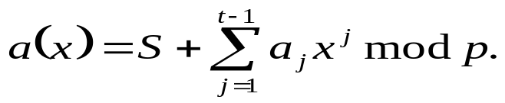
IV054
Shamir's (n,t)-threshold scheme
Initiation phase:
Dealer D chooses a prime p, n distinct x _{i}, 1 Ł i Ł n and D gives the values x _{i} to the user P _{i}.
The values x _{i} are public.
Share distribution: Suppose D wants to share a secret S ∈ Z _{p} among the users. D randomly chooses t -1 elements of Z _{p}, a ₁,…,a _{t-1}.
For 1 Ł i Ł n, D computes the “shares'' y _{i} = a(x _{i}),
where
For 1 Ł i Ł n , D gives the share y_{i} to the participant P _{i}.
Secret cumulation: Let participants P _{i1},…, P _{it} wants to determine secret S. Since a(x) has degree t-1, a(x) has the form
a(x) = a ₀ + a ₁x + … + a _{t-1}x ^{t-1},
the coeficients a _{i} can be obtained from t equations a (x _{ij}) = y _{ij}, where all arithmetic is done modulo p.
It can be easily show that equations obtained this way are linearly independent and the system has a unique solution.
In such a case S = a ₀.
Identification and Authentication

Slide 16
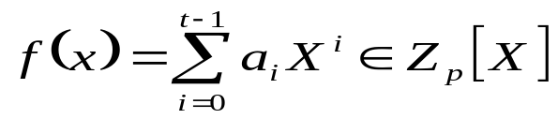
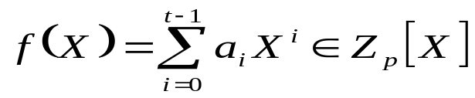
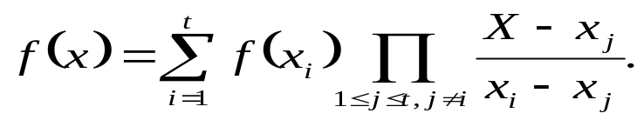
IV054
Shamir's scheme - technicalities
Shamir's scheme uses the following result concerning polynomials over fields Z_{p}, where p is prime.
Theorem Let be a polynomial of degree t -1 and let
P = {(x _{i}, f(x _{i})) | x _{i} ∈ Z_{p}, i =1,…,t, x _{i} ą x _{J}, i ą j }.For Q ⊆ P, let P _{Q} = { g ∈ Z _{p} [X] | deg(g) = t -1, g(x) = y for all (x,y) ∈ Q}. Then it holds:
P_{P} = {f(x)}, i.e. f is the only polynomial of degree t -1, whose graph contains all t points in P.
If Q ⊂ P is a proper subset of P and x ą 0 for all (x, y) ∈ Q, then each a ∈ Z _{p} appears with the same frequency as the constant coefficient of polynomials in P_{Q}.
Corollary (Lagrange formula) Let be a
polynomial and let P = {(x _{I}, f(x _{i})) | i = 1,…,t, x _{i} ą x _{J}, i ą j }. Then
Identification and Authentication

Slide 17
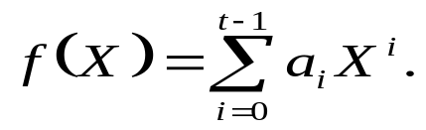
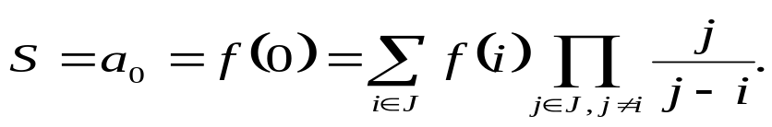
IV054
Shamir's (n,t)-threshold scheme
To distributes n shares of a secret S among users P ₁,…, P _{n} a trusted centre T proceeds as follows:
T chooses a prime p > max{S, n} and sets a ₀ = S.
T selects randomly a ₁,…, a _{t-1} ∈ Z _{p} and creates polynomial
T computes s _{i} = f (i), i = 1,…, n and transfers (i, s _{i}) to the user P _{i} in a secure way.
Any group J of t or more users can compute the secret. Indeed, from the previous collolary we have
In case |J| < t, then each a € Z _{p} is likely to be the secret.
Identification and Authentication

Slide 18
IV054
DIGITAL MONEY
Is it possible to have electronic money?
It seems that not, because copies of digital information are indistinguishable from origin and one could hardly prevent double spending,....
T. Okamoto and K. Ohta formulated six properties any digital money system should have.
One should be able to send e-money through e-networks.
It should not be possible to copy and reuse e-money.
Transactions using e-money should be done off-line - that is no communication with central bank should be needed during translation.
One should be able to sent e-money to anybody.
An e-coin could be divided into e-coins of smaller values.
Several system of e-money have been created that satisfy all or at least some of the above requirements.
Identification and Authentication

Slide 19
IV054
BLIND SIGNATURES - applications
Blind digital signatures allow the signer (bank) to sign a message without seeing its content.
Scenario: Customer Bob would like to give e-money to Shop. E-money are signed by a Bank. Shop must be able to verify Bank's signature. Later, when Shop sends e-money to Bank, Bank should not be able to recognize that it signed these e-money for Bob. Bank has therefore to sign money blindly.
Bob can obtain a blind signature for a message m from Bank by executing the Shnorr blind signature protocol described on next slide.
Basic setting
Bank chooses large primes p, q | (p -1) and an g ∈ Z _{p} of order q.
Let h: {0,1}* → Z _{p} be a collision-free hash function.
Bank's secret will be a randomly chosen x ∈ {0,…, p -1}.
Public information: (p, q, g, y = g ^{x} ).
Identification and Authentication

Slide 20
IV054
BLIND SIGNATURES - protocols
Shnorr's simplified identification protocol in which Bank proves its identity by proving that it knows x.
Bank chooses a random r ∈ {0,…,q -1} and send a = g ^{r} to Bob. {By that Bank ``commits’’ itself to r}.
Bob send to Bank a random c ∈ {0,…,q -1} {a challenge}.
Bank sends to Bob b = r - cx.
Bob accepts the proof if a = g ^{b} y ^{c}.
Transfer of the identification scheme to a signature scheme:
Bob does not choose c randomly but as c = h (m || a), where m is message to sign.
Signature: (c, b); Verification rule: a = g ^{b} y ^{c}; Transcript: (a, c, b).
Shnorr's blind signature scheme
Bank sends to Bob a’ = g ^{r’} with random r’ ∈ {0,…,q -1}.
Bob choses random u,v,w ∈ {0,…,q -1}, u ą 0, Computes a = a’ ^{u} g ^{v} y ^{w}, c = h (m||a), c’ = (c - w)u ⁻¹ and sends c’ to Bank.
Bank sends to Bob b’ = r’ - c’x.
Bob verifies whether a’ = g ^{b’}y ^{c’}, computes b = ub’ + v and gets blind signature σ(m) = (c, b) of m.
Verification condition for the blind signature: c = h (m || g ^{b} y ^{c}).
Both (a,c,b) and (a’,c’,b’) are valid transcripts.
Identification and Authentication

